Slide 1





Digital Portfolio
Name: SIVASAKTHI G
Registre No: 24524U18089
ID NM: 8620EE989D20E5FA816439B8C1774B7D
DEPARTMENT: "BSC"
COLLEGE NAME : Karan Arts and Science college, Thiruvannamai
UNIVERSITY: Thiruvalluvar university
1

Slide 2


PROJECT TITLE
INTERACTIVE DIGITAL PORTFOLIO
USINGFRONTENDWEB D EV EL OP ME NT
2

Slide 3



AGENDA
1.
Problem Statement Project Overview End Users Tools and Technologies
2. 3. 4.
Portfolio designandLayout
5.
6. 7. 8.
9.
Features and Functionality Results and Screenshots Conclusion
Github Link
3/21/2024 AnnualReview
3

Slide 4


PROBLEM STATEMENT
Mathematical operations like addition, subtraction, multiplication, and division are vital in daily life. Manualcalculations,however, areoften slowand error- prone, especially with large or complex expressions. Toa ddress this,the proposed calculator project offers a simple, efficient, and user-friendly solution that ensures accurate results, saves time, and supports basic to moderate operations through
an interactive interface.
4

Slide 5

PROJECT OVERVIEW
▪
Thisproject isabasiccalculatorweb app built using
▪
HTML, CSS, and JavaScript.
It performs operations such as:
• Addition
• •
Subtraction Multiplication
• •
Division Modulus
▪
Features: AC(Clear), DEL (Delete), Decimal input.
5

Slide 6
WHO ARE THE END USERS?
•
• •
Students: quick math calculations.
Teachers: simple tool in classrooms.
General Users: anyone needing an online calculator.
6

Slide 7


TOOLS AND TECHNIQUES
•HTML5 → Structure and layout
• • • •
CSS3 → Styling and UI design JavaScript (ES6) → Logic & interactivity Text Editor → (VS Code) Browser → (Chrome/Edge/Firefox)
7

Slide 8
FEATURES AND FUNCTIONALITY
•Perform basic arithmetic operations •Delete last digit using DEL
• • •
Reset calculation using AC
Support for decimal values
Real-time output display

Slide 9
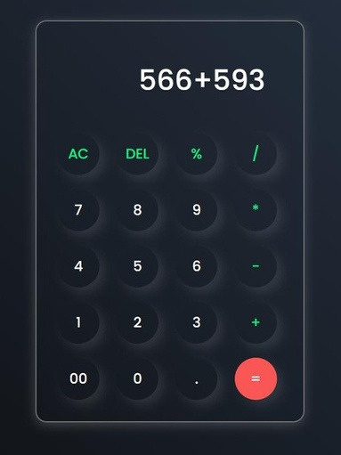
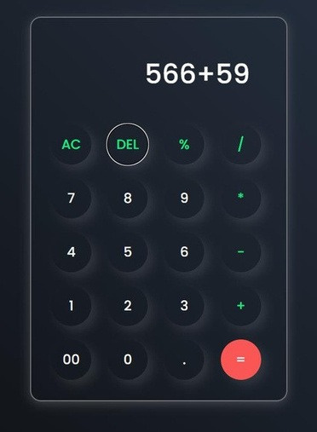
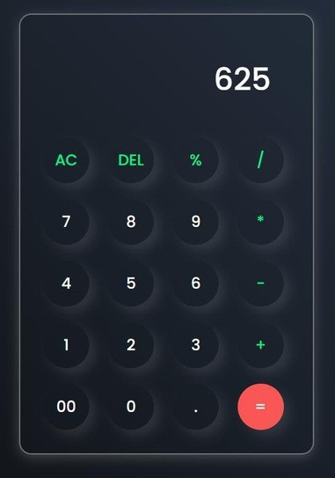

RESULTS AND SCREENSHOTS
8/28/2025 AnnualReview
10

Slide 10
CONCLUSION
The
calculator
project
demonstrates
the
implementationo f a simple andefficient tool for performing basic arithmetic operations such as addition, subtraction, multiplication, and division. It
offersaneasy-to-useinterface, reducesmanualerrors,
and improves accuracy and speed in solving problems. Through this project, I gained practical experience in programming, logic building, and user interface design.
Thecalculator
future enhancements, such as scientific functions, history tracking, and memory features.
alsoprovidesafoundationfor
11

